Slide 1
Proxy Design Pattern
The proxy pattern is a structural pattern that creates a proxy object.
The Proxy pattern provides a surrogate or placeholder object for another object and controls access to this other object.
It can help us control when an expensive object should be instantiated, provide advanced ways to reference the object or modify the object to function a particular way in specific contexts.
@ShankaragoudaG

Slide 2
Proxy Design Pattern
Usually, an object has an interface with several properties/methods that a client can access.
However, an object might not be able to deal with the clients’ requests alone due to heavy load or constraints such as dependency on a remote source that might cause delays (e.g., network requests).
In these situations, adding a proxy helps in dividing the load with the target object.

Slide 3
Proxy Design Pattern
The proxy object looks exactly like the target object. A client might not even know that they are accessing the proxy object instead of the target object.
The proxy handles the requests from the clients and forwards them to the target object. Hence, this prevents undue pressure on the target.
The proxy can also act as a cache and store the requests. When the same request is made again, it can just return it from the cache rather than forwarding it to the target. This allows the target to deal with a lesser number of requests.

Slide 4
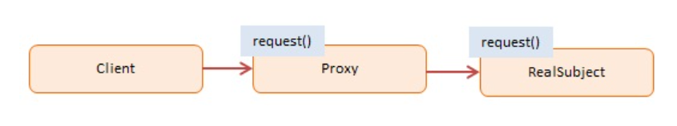
Digram
Client --
calls Proxy to request an operation
Proxy --
provides an interface similar to the real object
maintains a reference that lets the proxy access the real object
handles requests and forwards these to the real object
RealSubject --
defines the real object for which service is requested

Slide 5
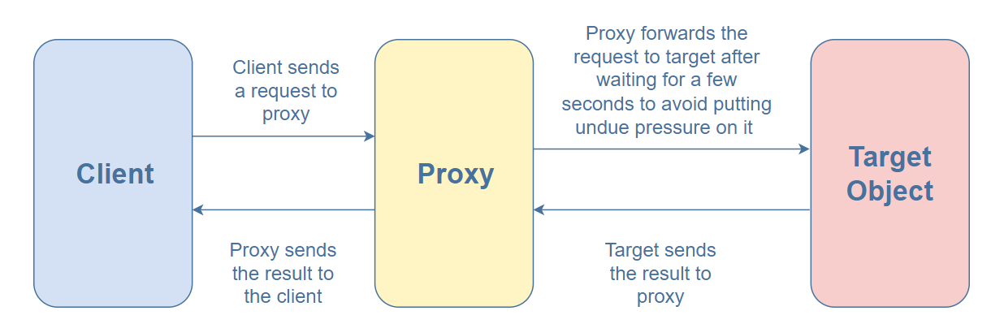
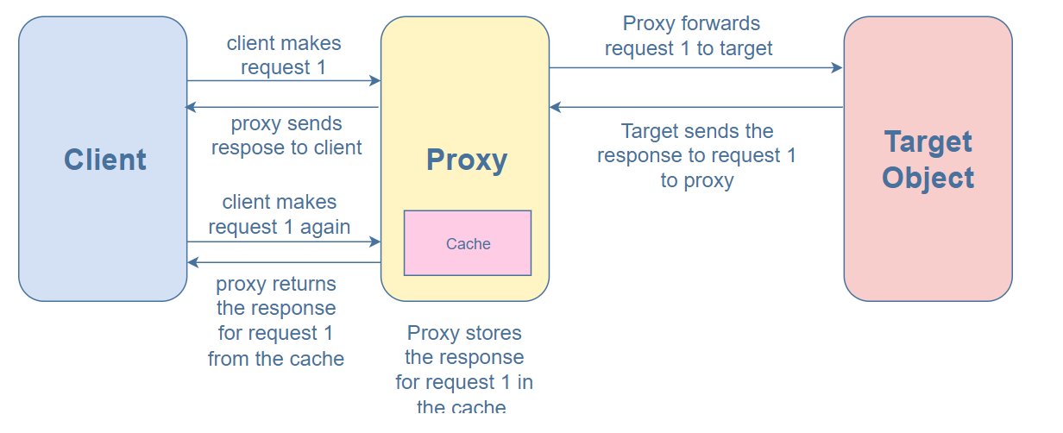
Example

Slide 6
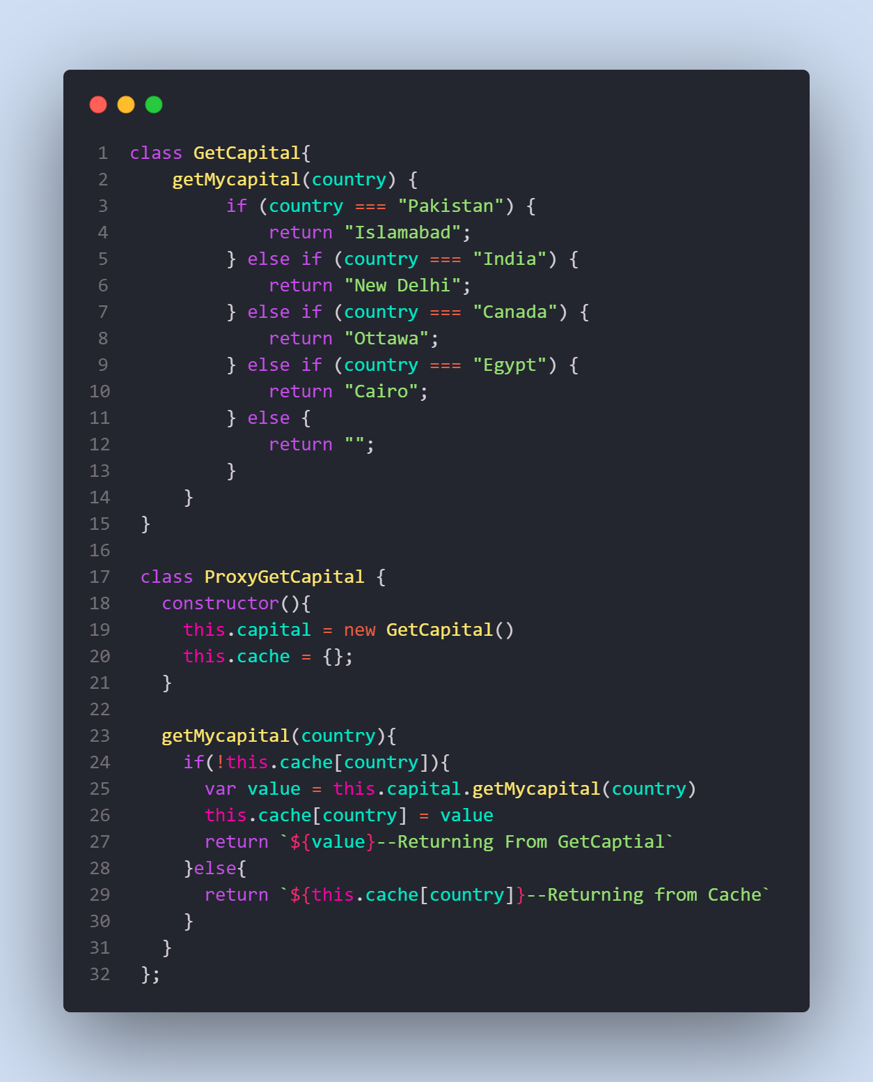
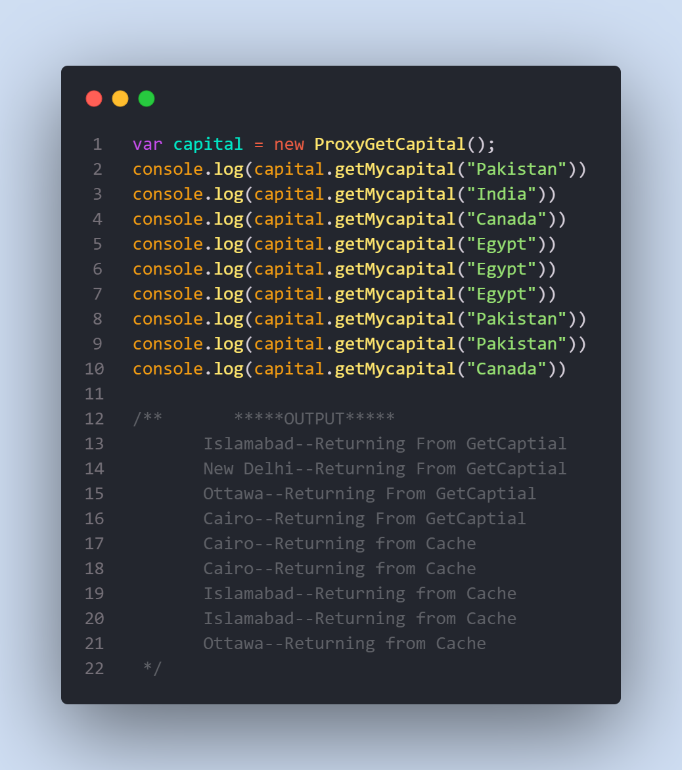

Slide 7
Useful Resources
https://www.dofactory.com/javascript/design-patterns/proxy
https://www.patterns.dev/posts/proxy-pattern/
https://www.educative.io/collection/page/5429798910296064/5725579815944192/6266691093790720

